Slide 1

Stock Price Forecasting Using Time Series
Mahesh Mangali

Slide 2

Project Overview:
Develop a time-series forecasting model to predict Apple’s stock price for the next 30 days.

Slide 3
Agenda
Data Collection
EDA and Data Preprocessing
Feature Engineering
Model Building & Evaluation
Deployment
Presentation Title

Slide 4
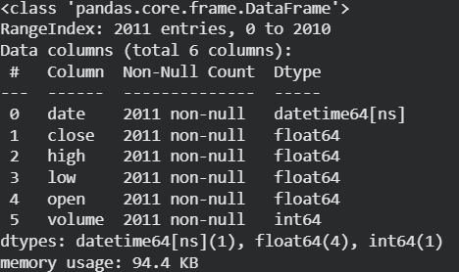
Dataset Overview:
Time Period : 2019 - 2025
Dataset Source : Yahoo Finance (AAPL stock)
Key Columns:
Date
Open, High, Low, Close
Volume
Dataset Characteristics:
Daily frequency time-series data
High volatility and trend patterns

Slide 5
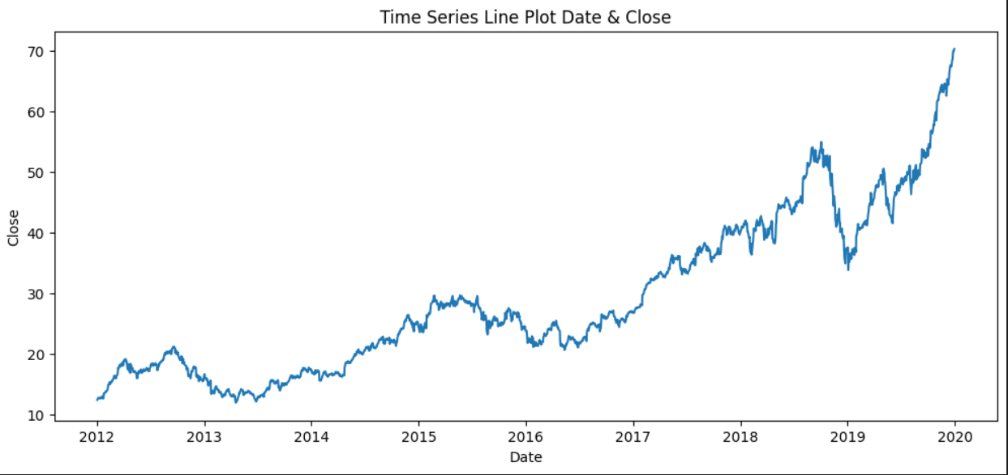
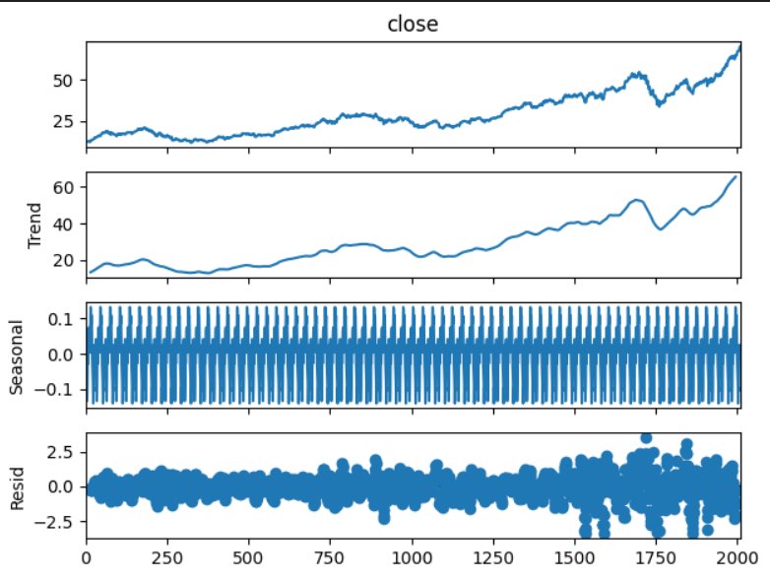
Exploratory Data Analysis
EDA Performed:
Line plots for close price trend analysis
Seasonal decomposition (trend, seasonality, residuals)
Monthly and quarterly resampling
Outlier detection using IQR method
Stationarity check using ADF test
Key Insights:
Long-term upward trend with short-term volatility
Non-stationary behavior in raw close prices
Stock Price Forecasting Using Time Series

Slide 6
Data Preprocessing
Steps Applied:
Converted date column to datetime index
Handled missing values using forward fill
Differenced close price to achieve stationarity
Removed infinite and null values
Outcome:
Clean and stationary dataset suitable for modeling
Stock Price Forecasting Using Time Series

Slide 7
Feature Engineering :
Time-Series Features:
Lag features (1, 2, 3, 5, 7, 14, 21 days)
Rolling means and moving averages
Technical Indicators
RSI (14), MACD, MACD Signal
Bollinger Bands
Exponential Moving Averages (EMA 9, 21, 50)
Date Features
Day of week
Month-end indicator

Slide 8





Model Building
Time-based train-test split (80% / 20%)
ARIMA
SARIMA
XGBOOST
LSTM
PROPHET
(Statistical models)
(Statistical models)
(Machine Learning)
(Deep Learning)
(Time – Serie Forecasting)
Evaluation Metrics:
RMSE (Root Mean Squared Error)
MAE (Mean Absolute Error)

Slide 9
Model Performances :
LSTM achieved the lowest error values among all models

Slide 10
Hyperparameter Tuning (Best Model)
Tuned Parameters for LSTM:
Number of units
Number of LSTM layers
Epochs
Batch size
Approach:
Grid search over multiple combinations
Selected configuration based on minimum RMSE

Slide 11

Deployment :
Saved trained LSTM model (.h5)
Saved MinMaxScaler using joblib
Built prediction pipeline for scaling and forecasting
Developed wilth Flask & Streamlit web application
Deployed using Ngrok for public access
Stock Price Forecasting Using Time Series

Slide 12
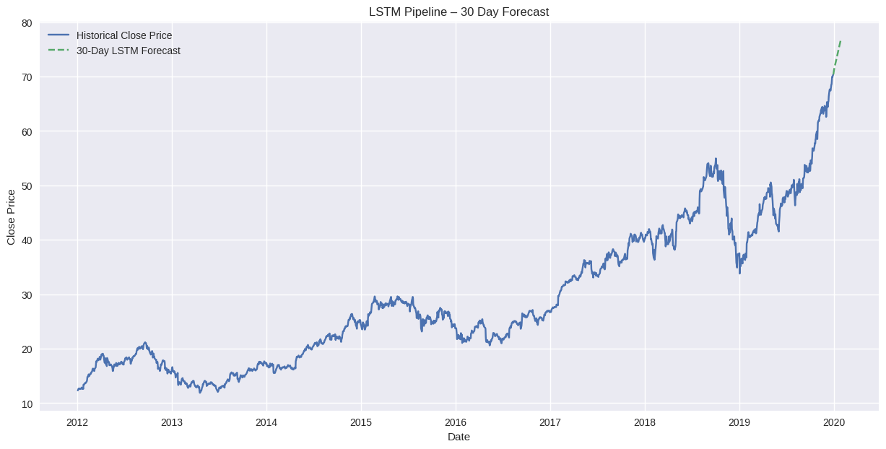
Final Output

Slide 13


Challenges Faced :
Achieving stationarity in time-series data
Feature leakage in ML models
Hyperparameter tuning for deep learning
Deployment configuration and environment setup
Future Enhancement :
Cloud deployment with auto-retraining
Real-time data streaming

Slide 14





Thank you…
Stock Price Forecasting Using Time Series

